Slide 1
Android Studio Installation
Group 1

Slide 2
Table of Content
Member our team
Introduction
System Requirements
Installation steps
Questions

Slide 3
member OUR TEAM
AL AZHAR RIZQI RIFA’I FIRDAUS
FAHRUDDIN ZAIM IBRAHIM WICAKSONO
MUHAMMAD BAIHAQI AULIA ASY’ARI
01
09
18
2241720263
2241720253
2241720145

Slide 4

INTRODUCTION
Android studio is the official Integrated Development Environment (IDE) for developing android apps which google supports. We can use various programming languages in android studio. For example java, kotlin, and flutter.
Reference : https://developer.android.com/studio

Slide 5
System Requirements
Operating System Version – Microsoft Windows 7/8/10/11 (32-bit or 64-bit).
Minimum 4 GB RAM and 8 GB RAM recommended.
Free Disk Space – Minimum 2 GB and 4 GB recommended.
Minimum Screen Resolution – 1280 * 800.resolution.

Slide 6
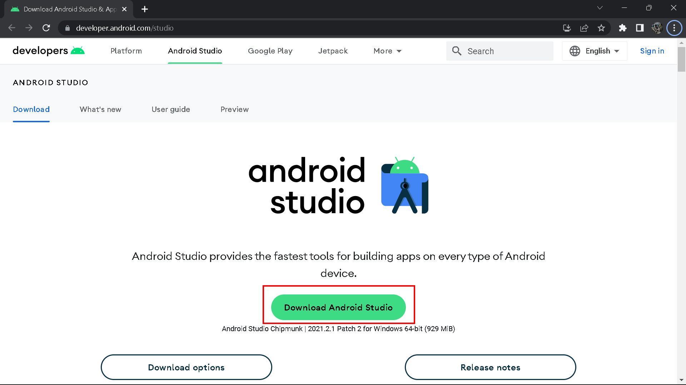
Installation Steps
First, Visit the official android studio website in your web browser to download android studio and then click download android studio.

Slide 7
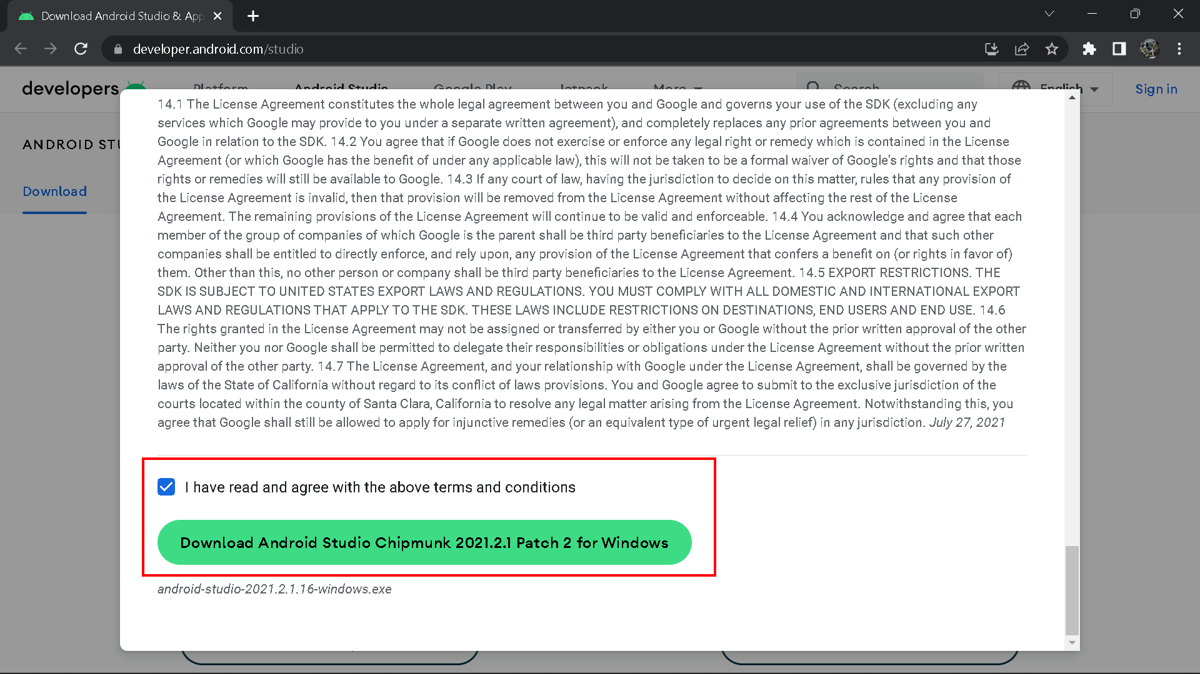
Installation Steps
After that read and agree to the terms and conditions, click download and wait until finish.

Slide 8
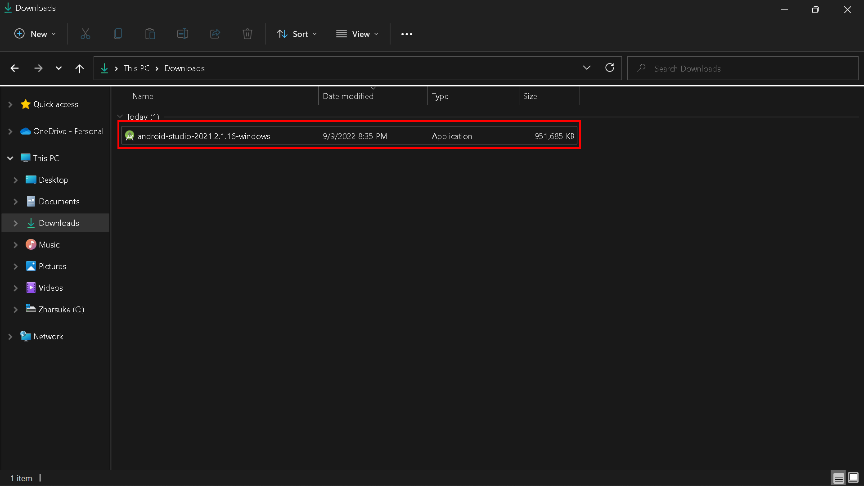
Installation Steps
Open file explorer, then double click on the downloaded “Android-studio.exe”

Slide 9
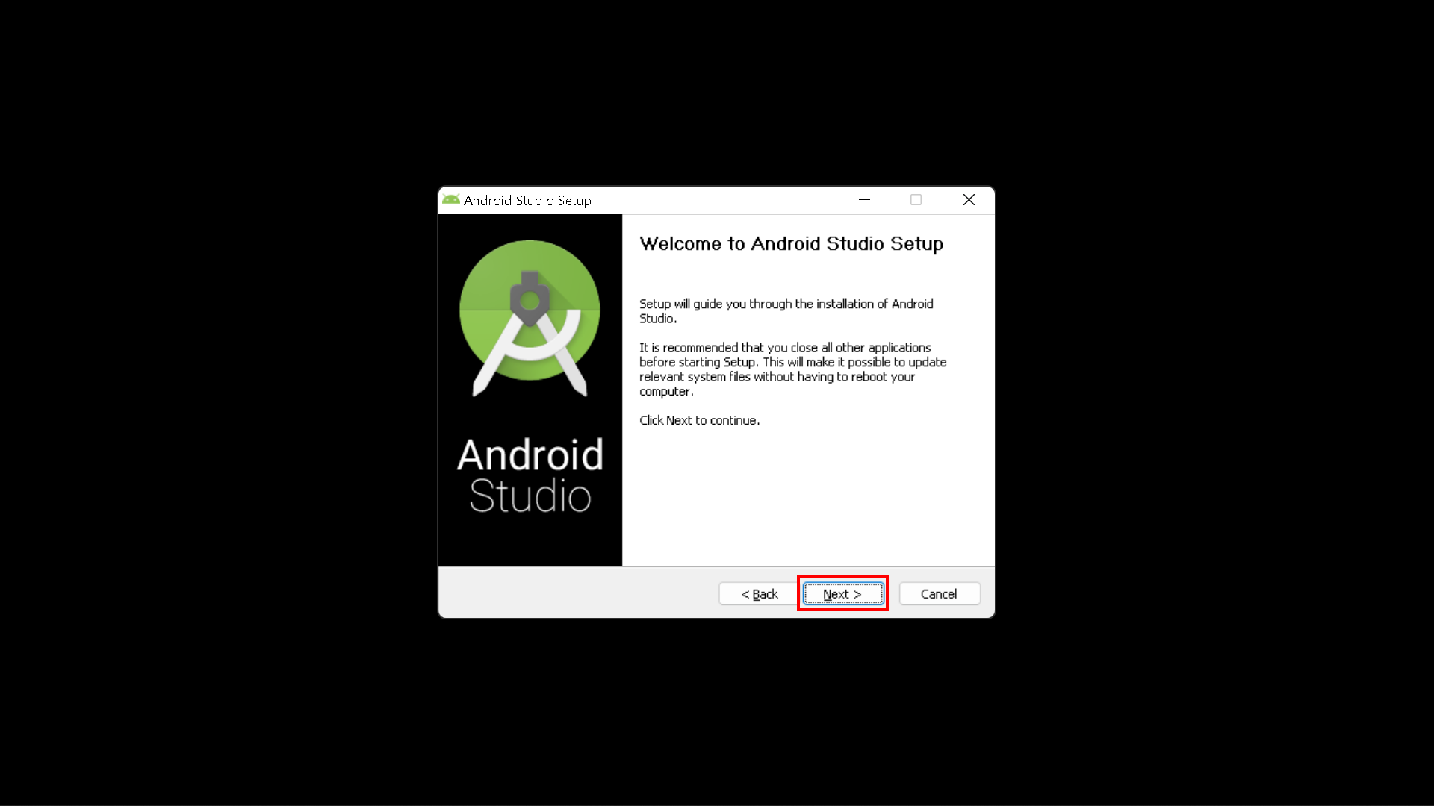
Installation Steps
Next, the “Android Studio Setup” will appear on the screen and then click “Next” to proceed.

Slide 10
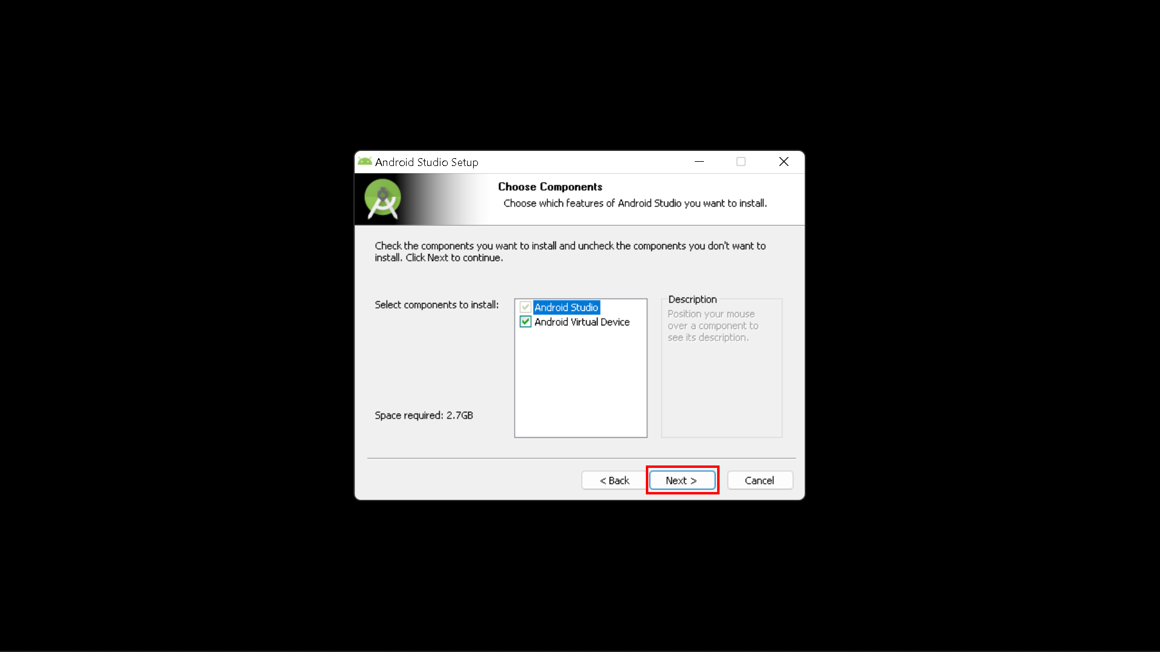
Installation Steps
Select the components that you want to install and click on the “Next” button.
Android Virtual Device (AVD) is a configuration that defines the characteristics of the android phone and tablet, wear OS, android tv, or automotive OS devices that you want to simulate in the android emulator.

Slide 11
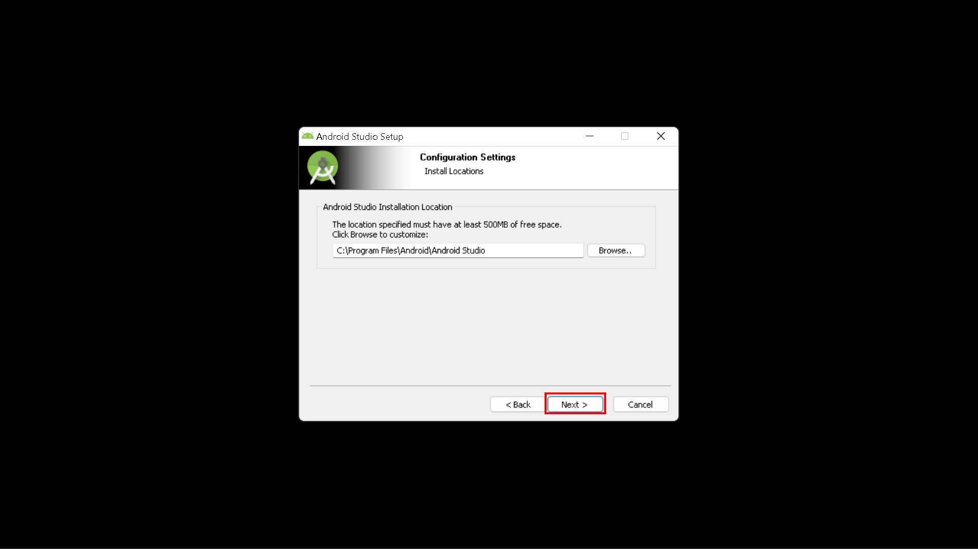
Installation Steps
Now, browse the location where you want to install the android studio and then click “Next” to proceed.

Slide 12
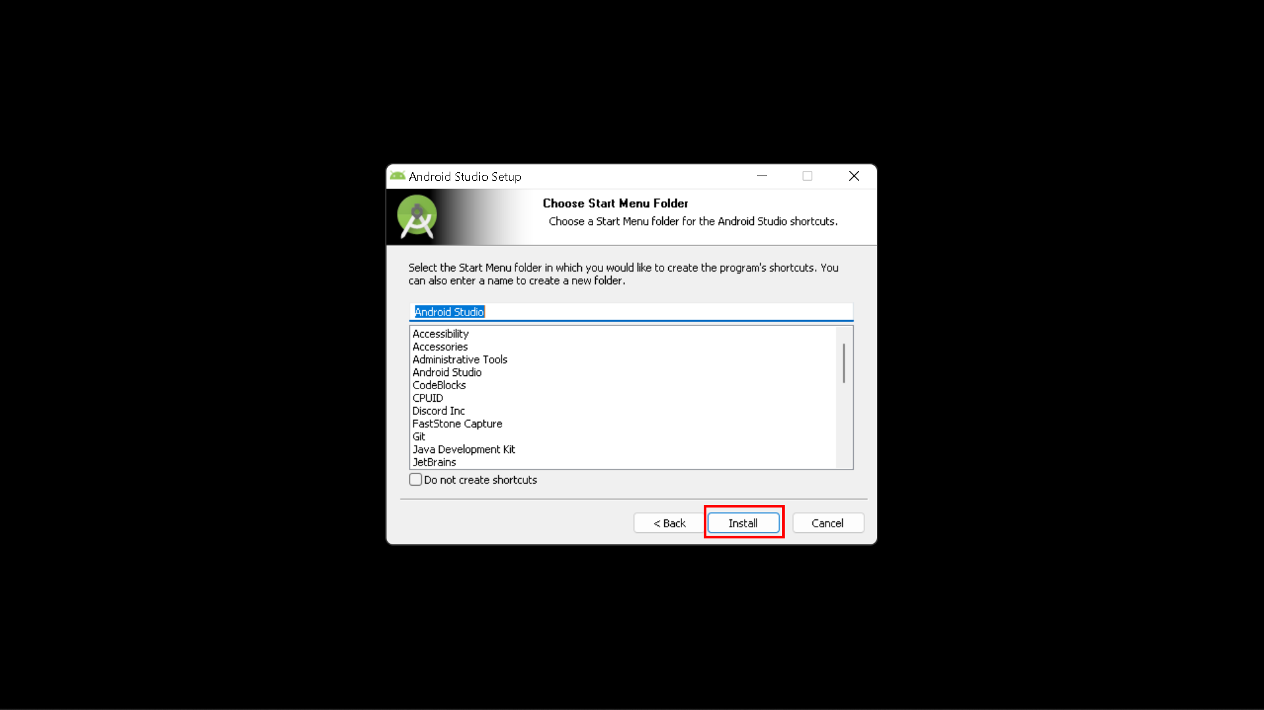
Installation Steps
Choose a start menu folder for the “Android Studio” shortcut and then click “Install” button to proceed.

Slide 13
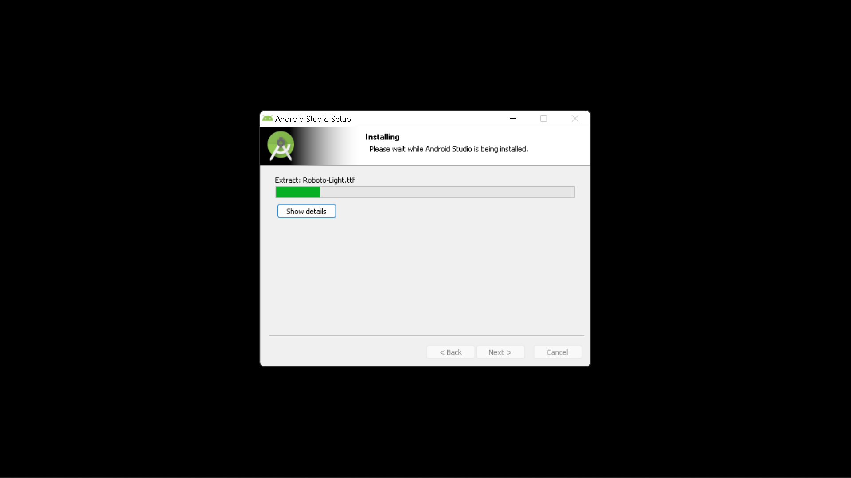
Installation Steps
Wait for the installation to finish.

Slide 14
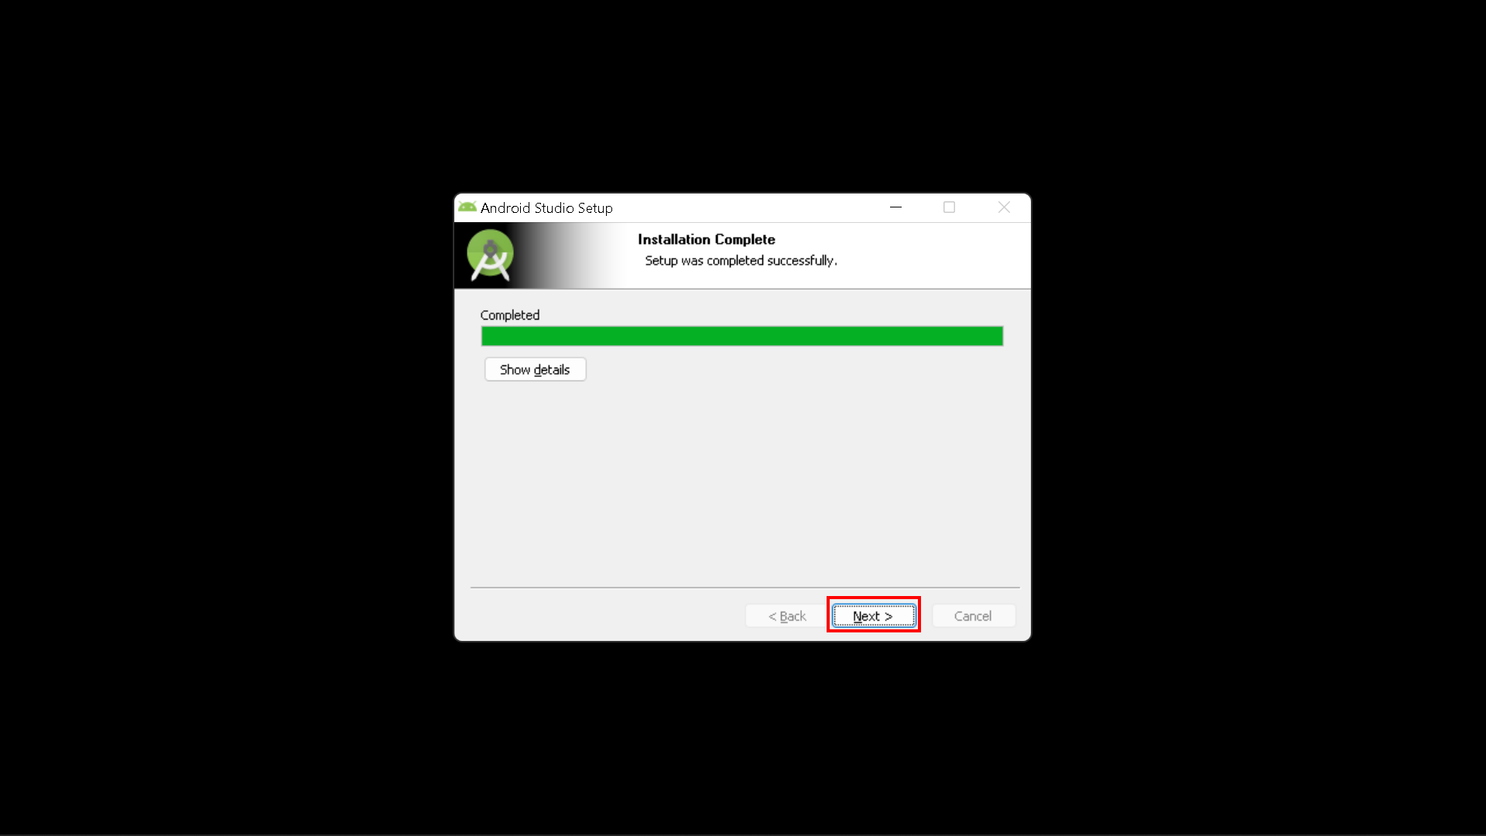
Installation Steps
After successful completion of the installation, click “Next” button.

Slide 15
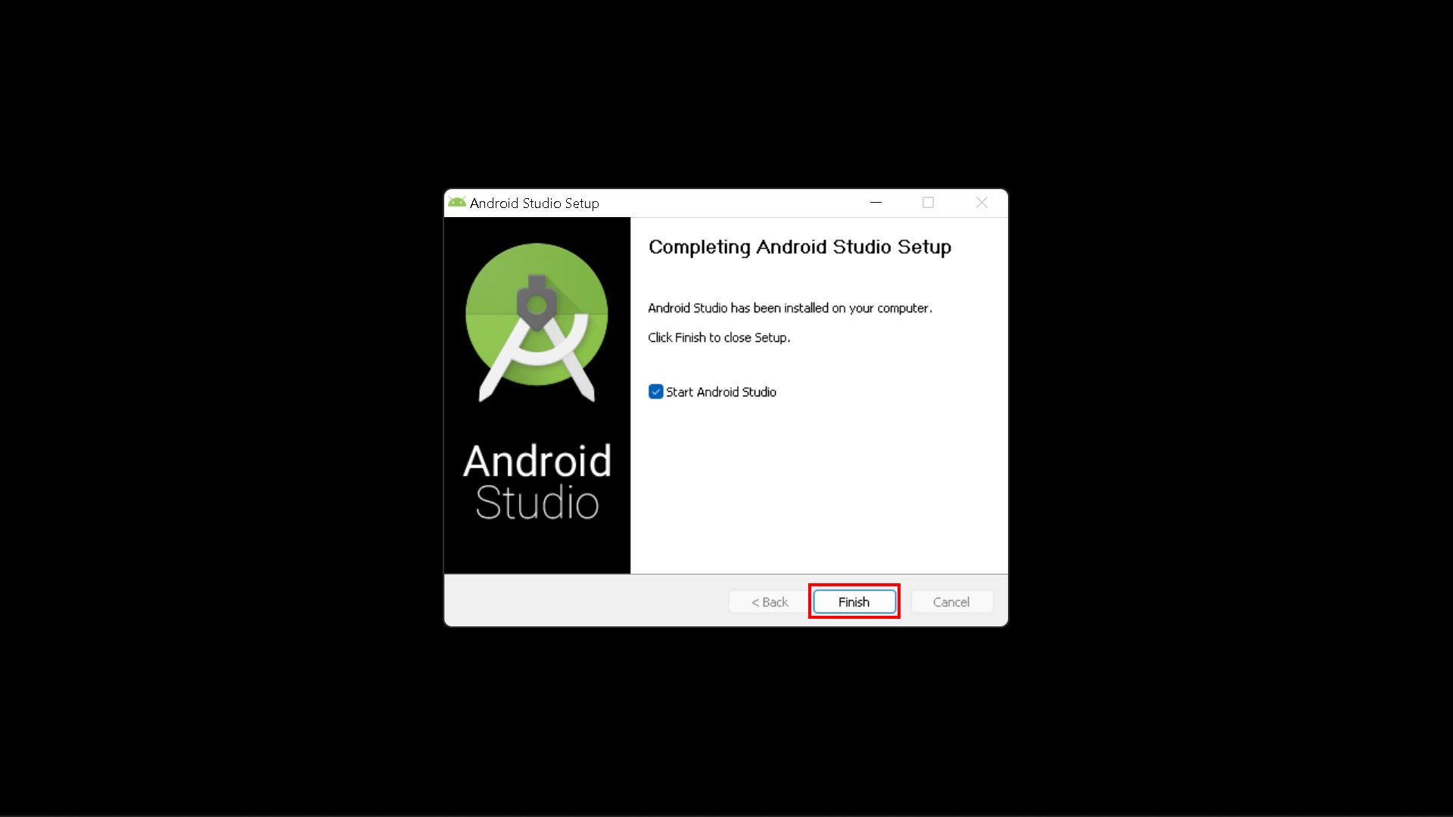
Installation Steps
Click on the “Finish” button to proceed.
Check the “Start Android Studio” box if you want to open android studio.

Slide 16
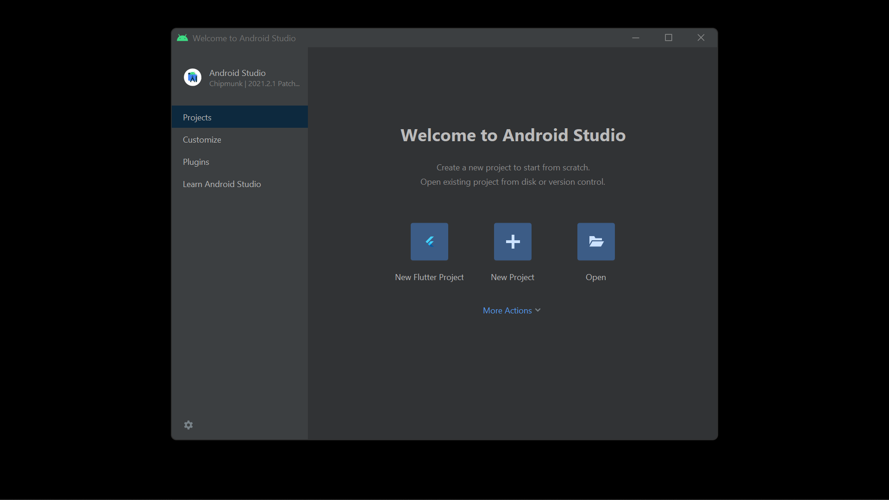
Installation Steps
Android studio installation successful.

Slide 17
Questions

Slide 18
THANK YOU
AL AZHAR RIZQI RIFA’I FIRDAUS
FAHRUDDIN ZAIM IBRAHIM WICAKSONO
MUHAMMAD BAIHAQI AULIA ASY’ARI

